Slide 1
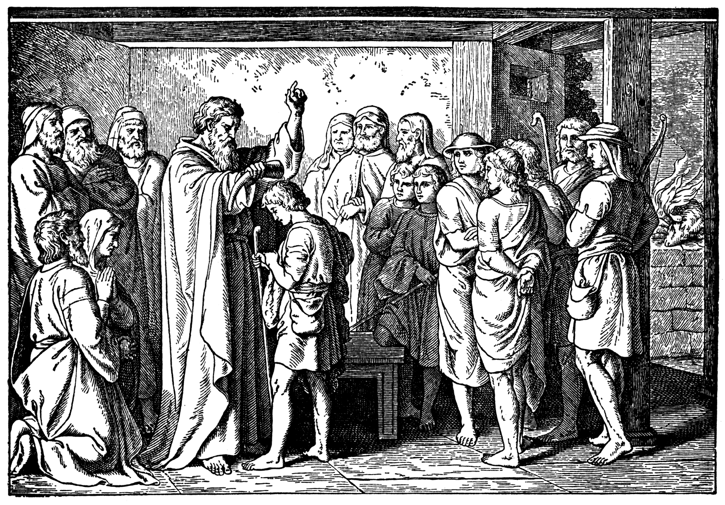
God Provides Himself a King

Slide 2
John 2:10 And saith unto him, Every man at the beginning doth set forth good wine; and when men have well drunk, then that which is worse: but thou hast kept the good wine until now.

Slide 3
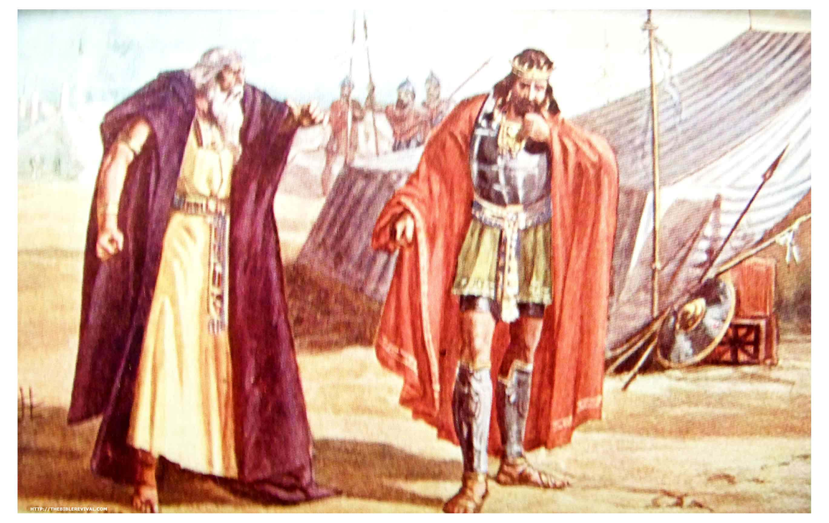
Weeping over a failed disciple.
Saul’s decision to rebel hurts.
Grieving is good, it’s healthy.
Grieving into daily paralysis is bad.

Slide 4
Psalm 37:4-5 Delight thyself also in the LORD; and he shall give thee the desires of thine heart. 5 Commit thy way unto the LORD; trust also in him; and he shall bring it to pass.

Slide 5
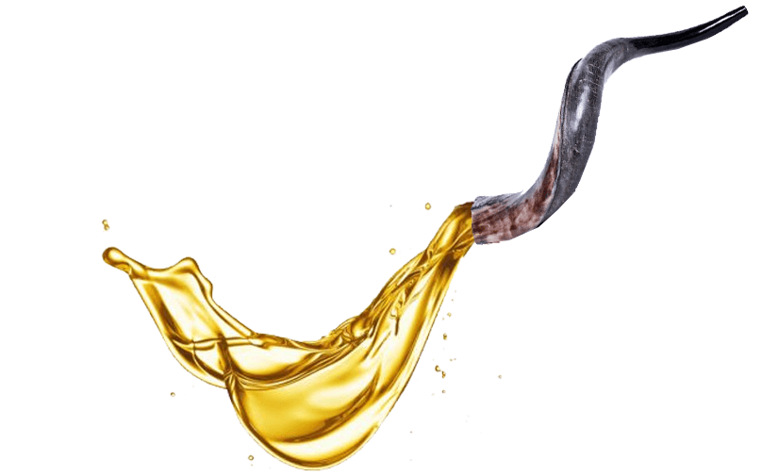
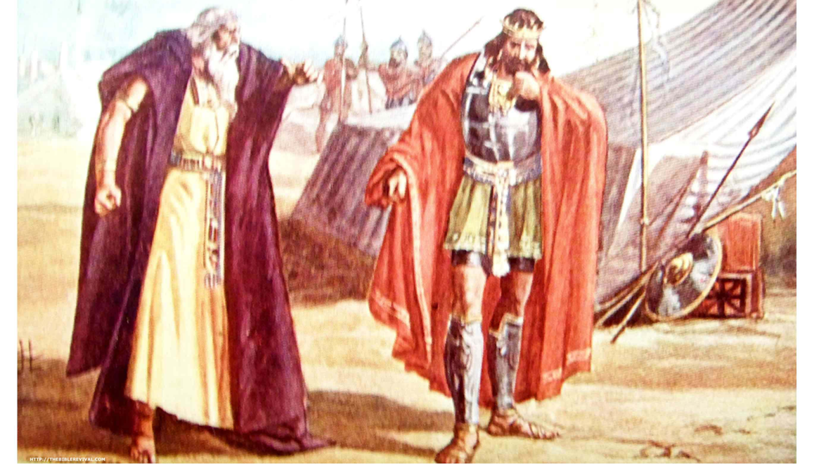
Weeping over a failed disciple.
Saul’s decision to rebel hurts.
Grieving is good, it’s healthy.
Grieving into daily paralysis is bad.
Submit to God’s will. Your emotions will follow.
The mission must move forward.

Slide 6
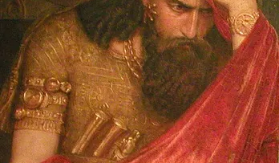
Fear over an evil king.
People don’t need to all as you obey God.
Don’t reveal details that will distract from the mission.
You don’t have to know the outcome to obey God now!
As you obey what you know, God gives more direction.

Slide 7
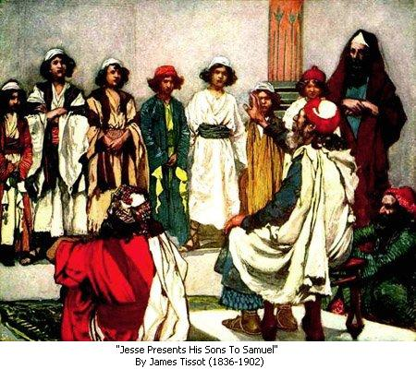
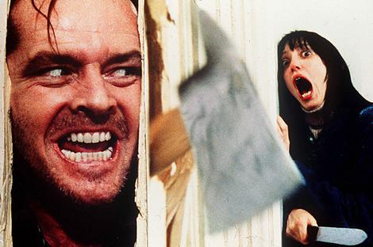
Samuel’s mission.
Peaceably? The “AGAG hacker” was here!
The CALL: Sacrifice to the LORD.
SANCTIFICATION:
No one that was ceremonially unclean could partake of a Levitical sacrifice.

Slide 8
Exodus 19:10-15 And the LORD said unto Moses, Go unto the people, and sanctify them to day and to morrow, and let them wash their clothes, 11 And be ready against the third day: for the third day the LORD will come down in the sight of all the people upon mount Sinai. 12 And thou shalt set bounds unto the people round about, saying, Take heed to yourselves, that ye go not up into the mount, or touch the border of it: whosoever toucheth the mount shall be surely put to death:

Slide 9
Exodus 19:13 There shall not an hand touch it, but he shall surely be stoned, or shot through; whether it be beast or man, it shall not live: when the trumpet soundeth long, they shall come up to the mount. 14 And Moses went down from the mount unto the people, and sanctified the people; and they washed their clothes. 15 And he said unto the people, Be ready against the third day: come not at your wives.

Slide 10

Samuel’s meeting.
REJECTION
Man looks on the face and form.
Proverbs 31:30 Favour is deceitful, and beauty is vain: but a woman that feareth the LORD, she shall be praised.
The LORD looks on the heart!

Slide 11
Jeremiah 17:10 I the LORD search the heart, I try the reins, even to give every man according to his ways, and according to the fruit of his doings.
1 Corinthians 4:5 Therefore judge nothing before the time, until the Lord come, who both will bring to light the hidden things of darkness, and will make manifest the counsels of the hearts: and then shall every man have praise of God.
John 7:24 Judge not according to the appearance, but judge righteous judgment.

Slide 12
Matthew 7:15-20 Beware of false prophets, which come to you in sheep's clothing, but inwardly they are ravening wolves. 16 Ye shall know them by their fruits. Do men gather grapes of thorns, or figs of thistles? 17 Even so every good tree bringeth forth good fruit; but a corrupt tree bringeth forth evil fruit. 18 A good tree cannot bring forth evil fruit, neither can a corrupt tree bring forth good fruit. 19 Every tree that bringeth not forth good fruit is hewn down, and cast into the fire. 20 Wherefore by their fruits ye shall know them.

Slide 13
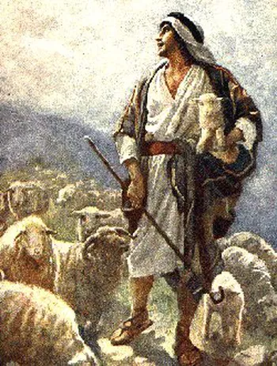
Samuel’s meeting.
SELECTION
  God chose what man rejects.
  David’s heart for the sheep.

Slide 14
Psalm 78:70-72 He chose David also his servant, and took him from the sheepfolds: 71 From following the ewes great with young he brought him to feed Jacob his people, and Israel his inheritance. 72 So he fed them according to the integrity of his heart; and guided them by the skilfulness of his hands.

Slide 15

Samuel’s meeting.
SELECTION
  God chose what man rejects.
  David’s heart for the sheep.
  David’s appearance.
  David’s anointing.

Slide 16
Luke 4:17-18 And there was delivered unto him the book of the prophet Esaias. And when he had opened the book, he found the place where it was written, 18 The Spirit of the Lord is upon me, because he hath anointed me to preach the gospel to the poor; he hath sent me to heal the brokenhearted, to preach deliverance to the captives, and recovering of sight to the blind, to set at liberty them that are bruised,

Slide 17
John 15:5 I am the vine, ye are the branches: He that abideth in me, and I in him, the same bringeth forth much fruit: for without me ye can do nothing.

Slide 18
1 Timothy 4:1 Now the Spirit speaketh expressly, that in the latter times some shall depart from the faith, giving heed to seducing spirits, and doctrines of devils;

Slide 19
Psalm 119:34 Give me understanding, and I shall keep thy law; yea, I shall observe it with my whole heart.

Slide 20
Psalm 119:97 O how love I thy law! it is my meditation all the day.

Slide 21
1 Samuel 13:13-14 And Samuel said to Saul, Thou hast done foolishly: thou hast not kept the commandment of the LORD thy God, which he commanded thee: for now would the LORD have established thy kingdom upon Israel for ever. 14 But now thy kingdom shall not continue: the LORD hath sought him a man after his own heart, and the LORD hath commanded him to be captain over his people, because thou hast not kept that which the LORD commanded thee.

Slide 22
Acts 13:22 And when he had removed him, he raised up unto them David to be their king; to whom also he gave testimony, and said, I have found David the son of Jesse, a man after mine own heart, which shall fulfil all my will.

Slide 23
God Provides Himself a King

